Slide 1
Data Mining:
Concepts and Techniques
— Chapter 2 —

Slide 2

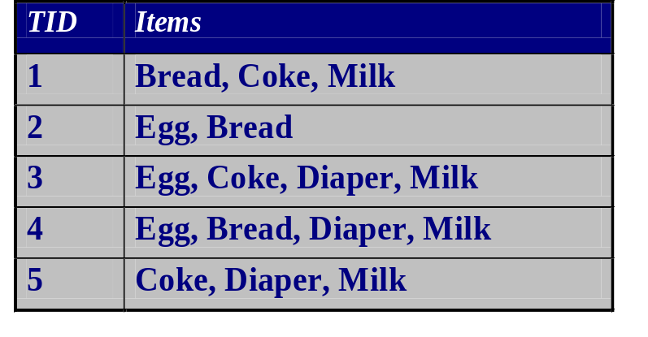
Data Objects and Attribute Types
Types of Data Sets
Record
  Relational records
  Data matrix, e.g., numerical matrix, crosstabs
  Document data: text documents: term-frequency vector
  Transaction data
Graph and network
  World Wide Web
  Social or information networks
  Molecular Structures
Ordered
  Video data: sequence of images
  Temporal data: time-series
  Sequential Data: transaction sequences
  Genetic sequence data
Spatial, image and multimedia:
  Spatial data: maps
  Image data:
  Video data:

Slide 3
Important Characteristics of Structured Data
Dimensionality
  Curse of dimensionality
Sparsity
  Only presence counts
Resolution
  Patterns depend on the scale
Distribution
  Centrality and dispersion

Slide 4
Data Objects
Data sets are made up of data objects.
A data object represents an entity.
Examples:
  sales database: customers, store items, sales
  medical database: patients, treatments
  university database: students, professors, courses
Also called samples , examples, instances, data points, objects, tuples.
Data objects are described by attributes.
Database rows -> data objects; columns ->attributes.

Slide 5
Attributes
Attribute (or dimensions, features, variables): a data field, representing a characteristic or feature of a data object.
  E.g., customer _ID, name, address
Types:
  Nominal
  Binary
  Numeric: quantitative
    Interval-scaled
    Ratio-scaled

Slide 6
Attribute Types
Nominal: categories, states, or “names of things”
  Hair_color = {auburn, black, blond, brown, grey, red, white}
  marital status, occupation, ID numbers, zip codes
Binary
  Nominal attribute with only 2 states (0 and 1)
  Symmetric binary: both outcomes equally important
    e.g., gender
  Asymmetric binary: outcomes not equally important.
    e.g., medical test (positive vs. negative)
    Convention: assign 1 to most important outcome
Ordinal
  Values have a meaningful order (ranking) but magnitude between successive values is not known.
  Size = {small, medium, large}, grades, army rankings

Slide 7
Numeric Attribute Types
Quantity (integer or real-valued)
Interval
    Measured on a scale of equal-sized units
    Values have order
      E.g., temperature in C˚or F˚, calendar dates
    No true zero-point
Ratio
    Inherent zero-point
    We can speak of values as being an order of magnitude larger than the unit of measurement (10 K˚ is twice as high as 5 K˚).
      e.g., temperature in Kelvin, length, counts, monetary quantities

Slide 8
Discrete vs. Continuous Attributes
Discrete Attribute
  Has only a finite or countably infinite set of values
    E.g., zip codes, profession, or the set of words in a collection of documents
  Sometimes, represented as integer variables
  Note: Binary attributes are a special case of discrete attributes
Continuous Attribute
  Has real numbers as attribute values
    E.g., temperature, height, or weight
  Practically, real values can only be measured and represented using a finite number of digits
  Continuous attributes are typically represented as floating-point variables

Slide 9
Basic Statistical Descriptions of Data
Motivation
  To better understand the data: central tendency, variation and spread
Data dispersion characteristics
  median, max, min, quantiles, outliers, variance, etc.
Numerical dimensions correspond to sorted intervals
  Data dispersion: analyzed with multiple granularities of precision
  Boxplot or quantile analysis on sorted intervals
Dispersion analysis on computed measures
  Folding measures into numerical dimensions
  Boxplot or quantile analysis on the transformed cube

Slide 10
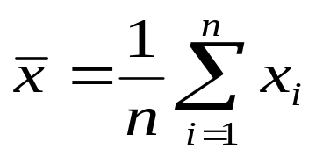


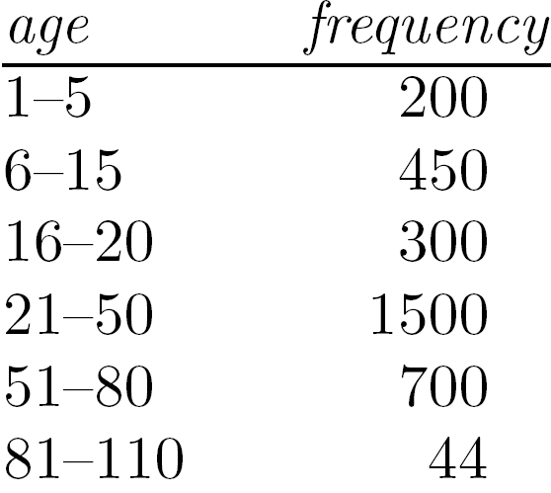
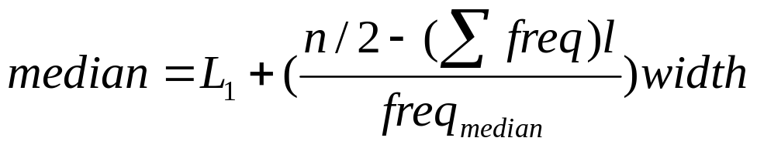
Measuring the Central Tendency
Mean (algebraic measure) (sample vs. population):
  Note: n is sample size and N is population size.
  Weighted arithmetic mean:
  Trimmed mean: chopping extreme values
Median:
  Middle value if odd number of values, or average of the middle two values otherwise
  Estimated by interpolation (for grouped data):
Mode
  Value that occurs most frequently in the data
  Unimodal, bimodal, trimodal
  Empirical formula:

Slide 11



Symmetric vs. Skewed Data
Median, mean and mode of symmetric, positively and negatively skewed data
symmetric
positively skewed
negatively skewed
Data Mining: Concepts and Techniques

Slide 12


Measuring the Dispersion of Data
Quartiles, outliers and boxplots
  Quartiles: Q₁ (25th percentile), Q₃ (75th percentile)
  Inter-quartile range: IQR = Q₃ – Q₁
  Five number summary: min, Q₁, median, Q₃, max
  Boxplot: ends of the box are the quartiles; median is marked; add whiskers, and plot outliers individually
  Outlier: usually, a value higher/lower than 1.5 x IQR
Variance and standard deviation (sample: s, population: σ)
  Variance: (algebraic, scalable computation)
  Standard deviation s (or σ) is the square root of variance s² ⁽or σ²⁾

Slide 13
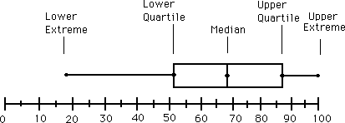
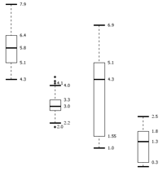
Boxplot Analysis
Five-number summary of a distribution
  Minimum, Q1, Median, Q3, Maximum
Boxplot
  Data is represented with a box
  The ends of the box are at the first and third quartiles, i.e., the height of the box is IQR
  The median is marked by a line within the box
  Whiskers: two lines outside the box extended to Minimum and Maximum
  Outliers: points beyond a specified outlier threshold, plotted individually

Slide 14

Visualization of Data Dispersion: 3-D Boxplots
Data Mining: Concepts and Techniques

Slide 15
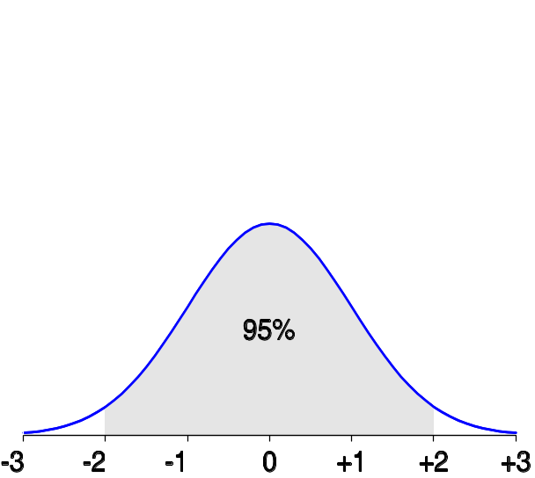
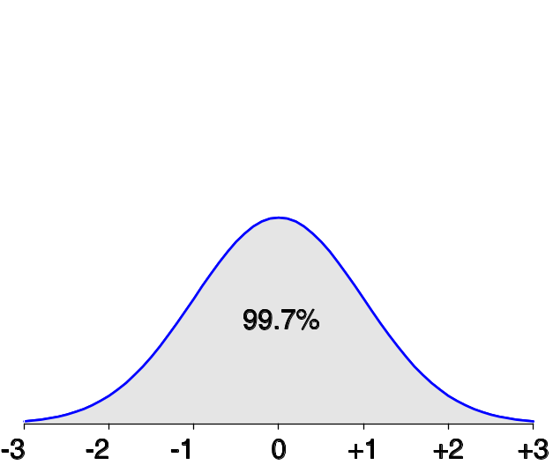
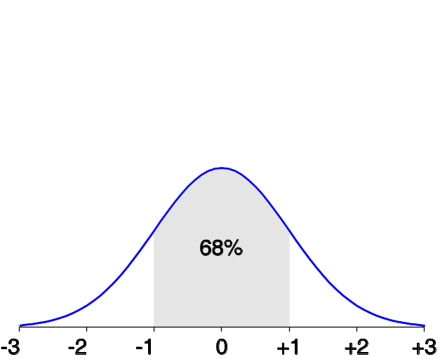
Properties of Normal Distribution Curve
The normal (distribution) curve
  From μ–σ to μ+σ: contains about 68% of the measurements (μ: mean, σ: standard deviation)
  From μ–2σ to μ+2σ: contains about 95% of it
  From μ–3σ to μ+3σ: contains about 99.7% of it

Slide 16
Graphic Displays of Basic Statistical Descriptions
Boxplot: graphic display of five-number summary
Histogram: x-axis are values, y-axis repres. frequencies
Quantile plot: each value x_{i} is paired with f_{i} indicating that approximately 100 f_{i} % of data are ≤ x_{i}
Quantile-quantile (q-q) plot: graphs the quantiles of one univariant distribution against the corresponding quantiles of another
Scatter plot: each pair of values is a pair of coordinates and plotted as points in the plane

Slide 17
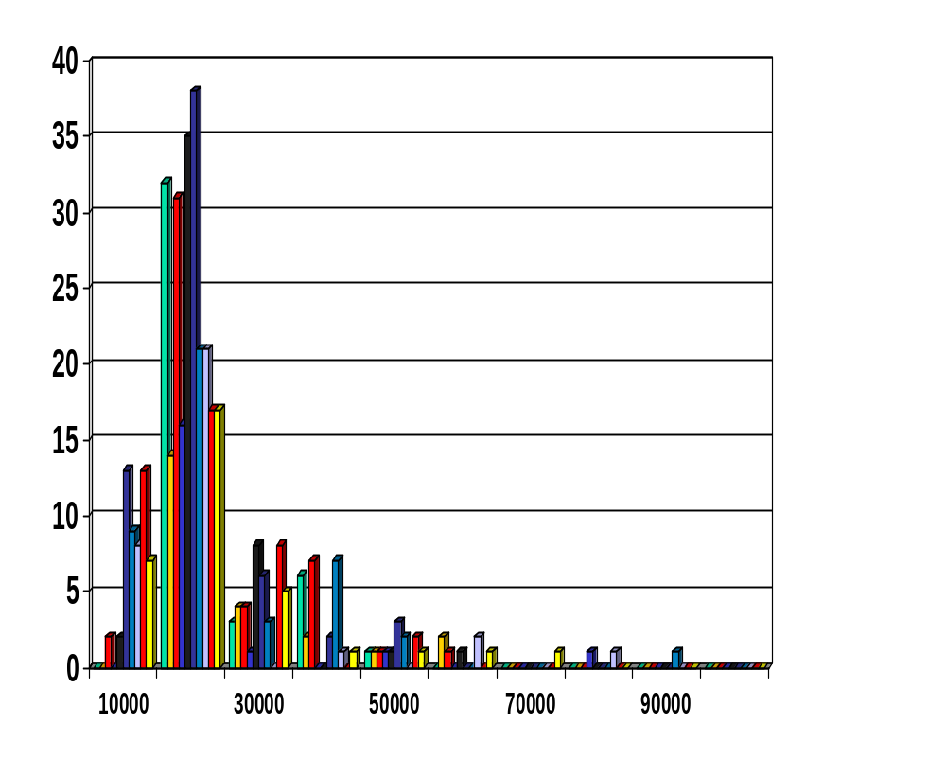
Histogram Analysis
Histogram: Graph display of tabulated frequencies, shown as bars
It shows what proportion of cases fall into each of several categories
Differs from a bar chart in that it is the area of the bar that denotes the value, not the height as in bar charts, a crucial distinction when the categories are not of uniform width
The categories are usually specified as non-overlapping intervals of some variable. The categories (bars) must be adjacent

Slide 18
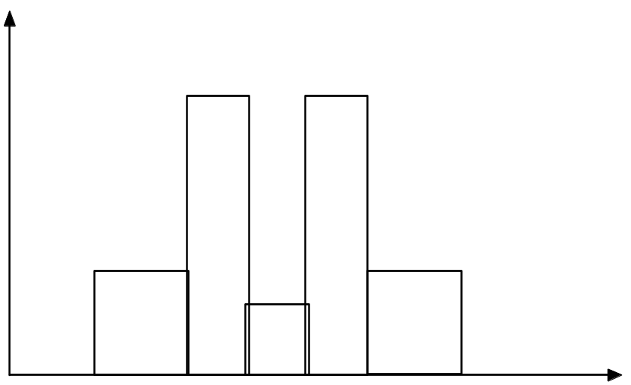
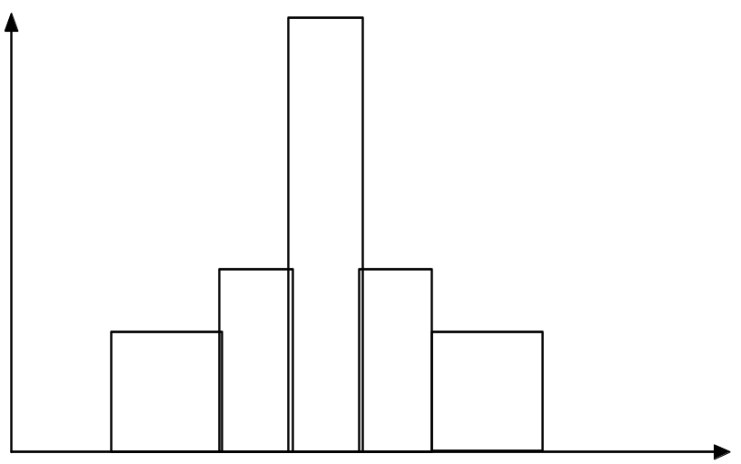
Histograms Often Tell More than Boxplots
The two histograms shown in the left may have the same boxplot representation
  The same values for: min, Q1, median, Q3, max
But they have rather different data distributions

Slide 19
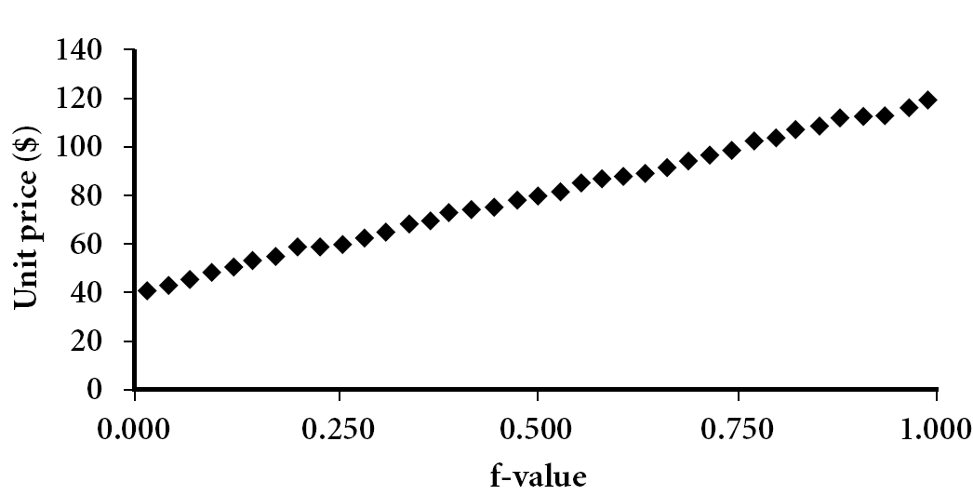
Quantile Plot
Displays all of the data (allowing the user to assess both the overall behavior and unusual occurrences)
Plots quantile information
  For a data x_{i} data sorted in increasing order, f_{i} indicates that approximately 100 f_{i}% of the data are below or equal to the value x_{i}
Data Mining: Concepts and Techniques

Slide 20
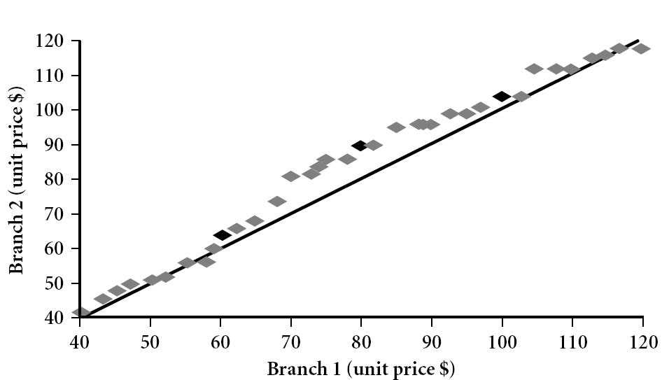
Quantile-Quantile (Q-Q) Plot
Graphs the quantiles of one univariate distribution against the corresponding quantiles of another
View: Is there is a shift in going from one distribution to another?
Example shows unit price of items sold at Branch 1 vs. Branch 2 for each quantile. Unit prices of items sold at Branch 1 tend to be lower than those at Branch 2.
Notes:
Note: We need to label the dark plotted points as Q1, Median, Q3 – that would help in understanding this graph.
Tell audience: There is a shift in distribution of branch 1 WRT branch 2 in that the unit prices of items sold at branch 1 tend to be lower than those at branch 2.

Slide 21
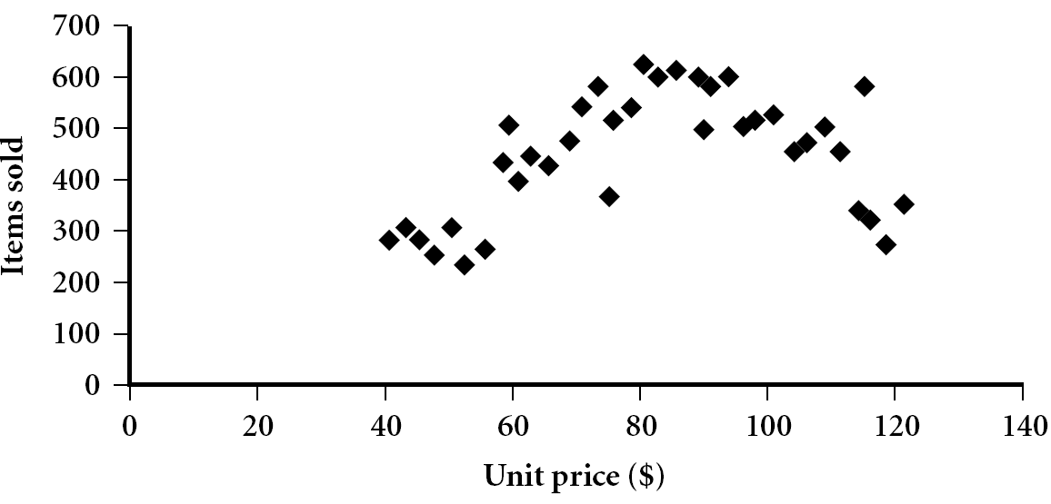
Scatter plot
Provides a first look at bivariate data to see clusters of points, outliers, etc
Each pair of values is treated as a pair of coordinates and plotted as points in the plane

Slide 22


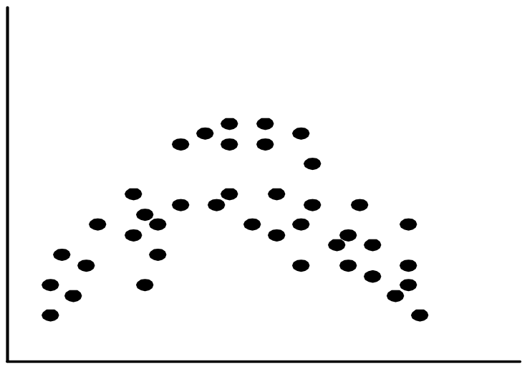
Positively and Negatively Correlated Data
The left half fragment is positively correlated
The right half is negative correlated

Slide 23


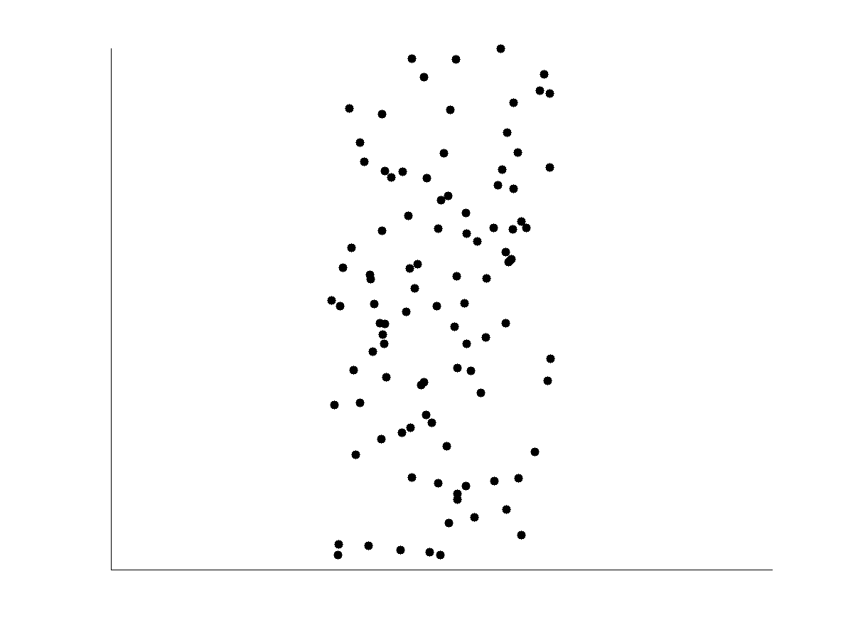
Uncorrelated Data

Slide 24
Chapter 2: Getting to Know Your Data
Data Objects and Attribute Types
Basic Statistical Descriptions of Data
Data Visualization
Measuring Data Similarity and Dissimilarity
Summary

Slide 25
Data Visualization
Why data visualization?
  Gain insight into an information space by mapping data onto graphical primitives
  Provide qualitative overview of large data sets
  Search for patterns, trends, structure, irregularities, relationships among data
  Help find interesting regions and suitable parameters for further quantitative analysis
  Provide a visual proof of computer representations derived
Categorization of visualization methods:
  Pixel-oriented visualization techniques
  Geometric projection visualization techniques
  Icon-based visualization techniques
  Hierarchical visualization techniques
  Visualizing complex data and relations

Slide 26
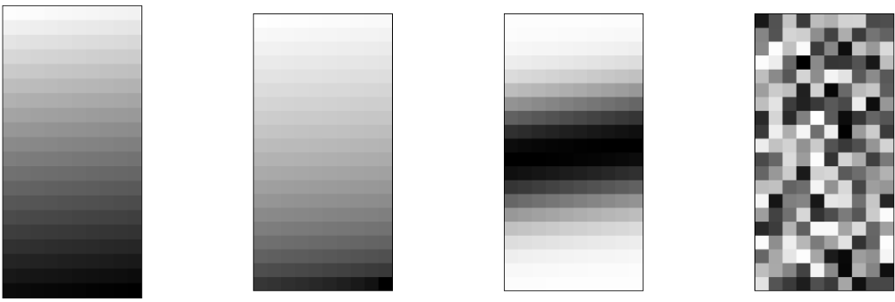
Pixel-Oriented Visualization Techniques
For a data set of m dimensions, create m windows on the screen, one for each dimension
The m dimension values of a record are mapped to m pixels at the corresponding positions in the windows
The colors of the pixels reflect the corresponding values
Income
(b) Credit Limit
(c) transaction volume
(d) age

Slide 27
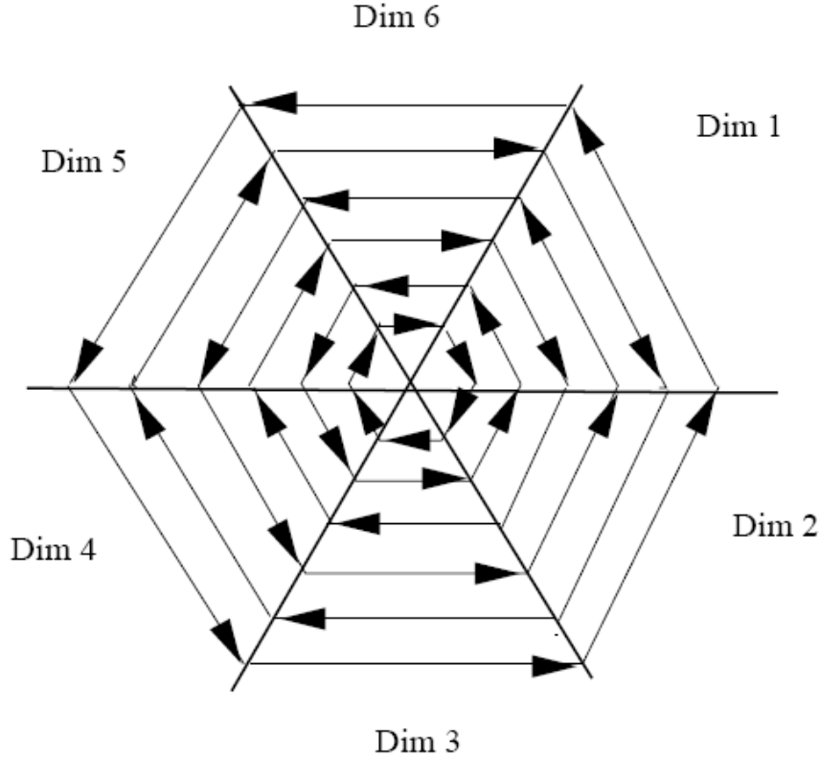
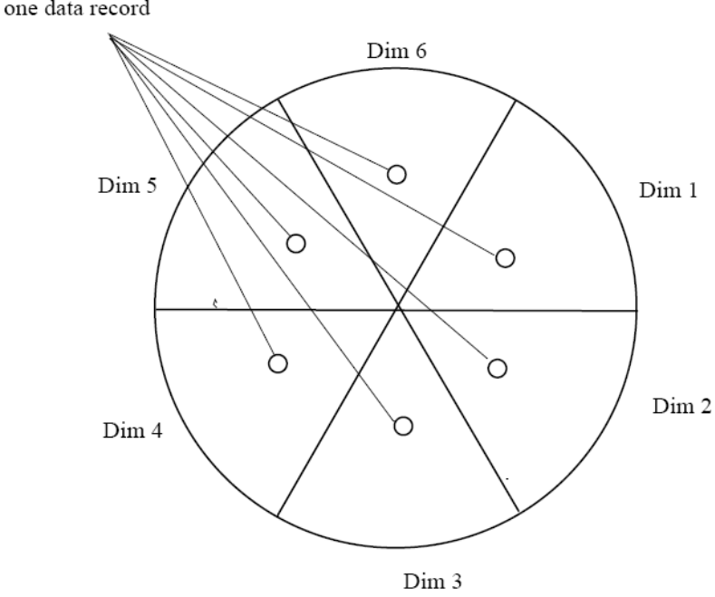
Laying Out Pixels in Circle Segments
To save space and show the connections among multiple dimensions, space filling is often done in a circle segment
Representing a data record in circle segment
(b) Laying out pixels in circle segment

Slide 28
Geometric Projection Visualization Techniques
Visualization of geometric transformations and projections of the data
Methods
  Direct visualization
  Scatterplot and scatterplot matrices
  Landscapes
  Projection pursuit technique: Help users find meaningful projections of multidimensional data
  Prosection views
  Hyperslice
  Parallel coordinates

Slide 29
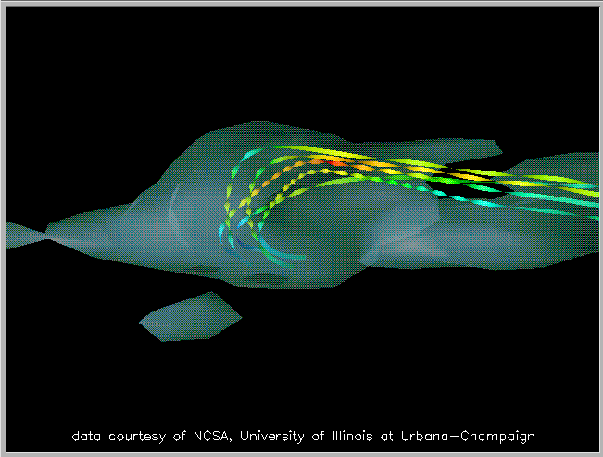
Direct Data Visualization
Ribbons with Twists Based on Vorticity
Data Mining: Concepts and Techniques
Notes:
http://books.elsevier.com/companions/1558606890/pictures/Chapter_01/fig1-6b.gif

Slide 30
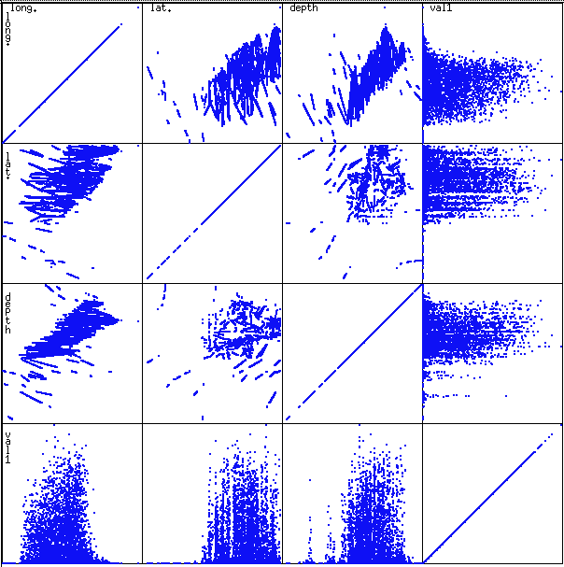
Scatterplot Matrices
Used by ermission of M. Ward, Worcester Polytechnic Institute
Matrix of scatterplots (x-y-diagrams) of the k-dim. data [total of (k2/2-k) scatterplots]

Slide 31
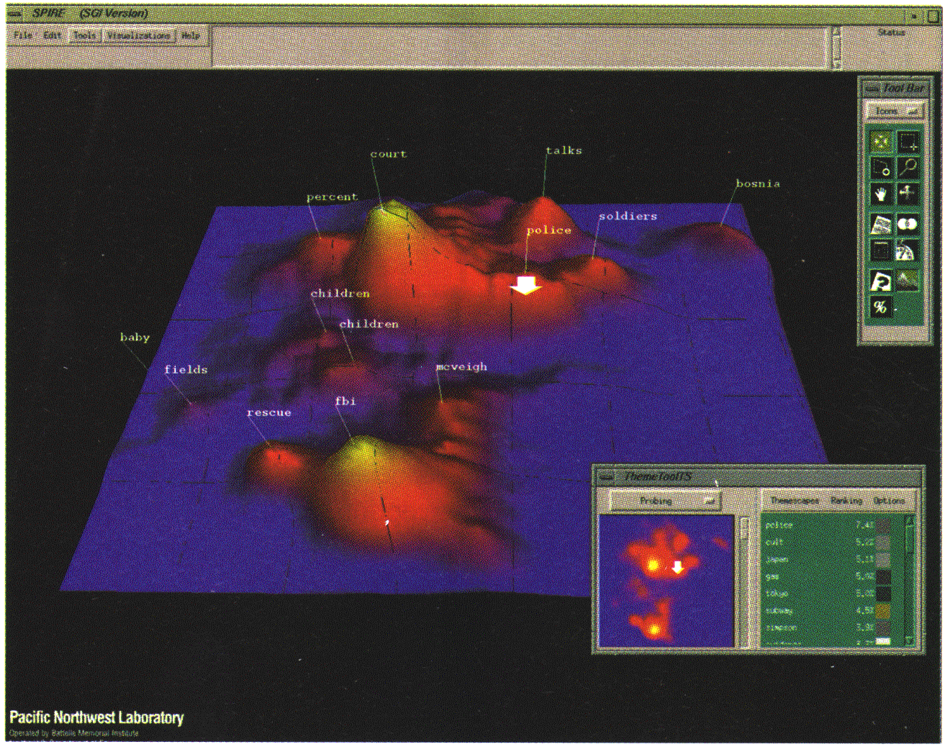
Landscapes
news articles
visualized as
a landscape
Used by permission of B. Wright, Visible Decisions Inc.
Visualization of the data as perspective landscape
The data needs to be transformed into a (possibly artificial) 2D spatial representation which preserves the characteristics of the data

Slide 32
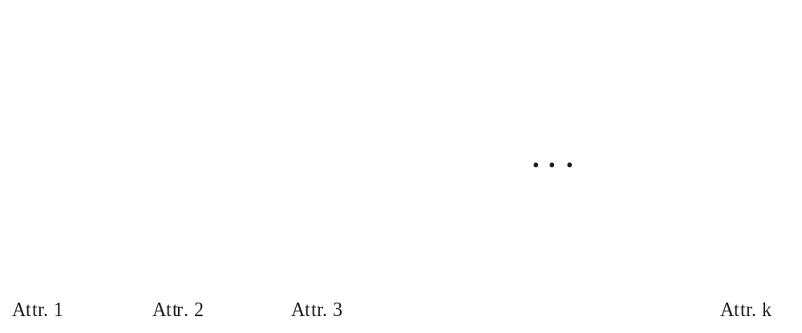
Parallel Coordinates
n equidistant axes which are parallel to one of the screen axes and correspond to the attributes
The axes are scaled to the [minimum, maximum]: range of the corresponding attribute
Every data item corresponds to a polygonal line which intersects each of the axes at the point which corresponds to the value for the attribute

Slide 33
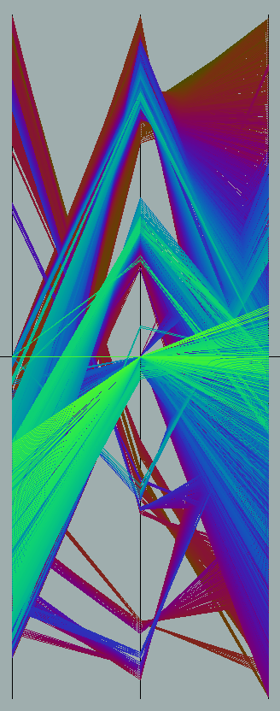
Parallel Coordinates of a Data Set

Slide 34
Icon-Based Visualization Techniques
Visualization of the data values as features of icons
Typical visualization methods
  Chernoff Faces
  Stick Figures
General techniques
  Shape coding: Use shape to represent certain information encoding
  Color icons: Use color icons to encode more information
  Tile bars: Use small icons to represent the relevant feature vectors in document retrieval

Slide 35
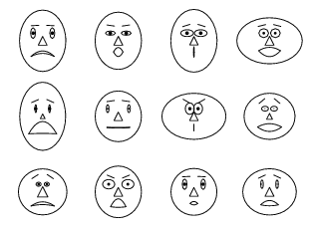
Chernoff Faces
A way to display variables on a two-dimensional surface, e.g., let x be eyebrow slant, y be eye size, z be nose length, etc.
The figure shows faces produced using 10 characteristics--head eccentricity, eye size, eye spacing, eye eccentricity, pupil size, eyebrow slant, nose size, mouth shape, mouth size, and mouth opening): Each assigned one of 10 possible values, generated using Mathematica (S. Dickson)
REFERENCE: Gonick, L. and Smith, W. The Cartoon Guide to Statistics. New York: Harper Perennial, p. 212, 1993
Weisstein, Eric W. "Chernoff Face." From MathWorld--A Wolfram Web Resource. mathworld.wolfram.com/ChernoffFace.html

Slide 36
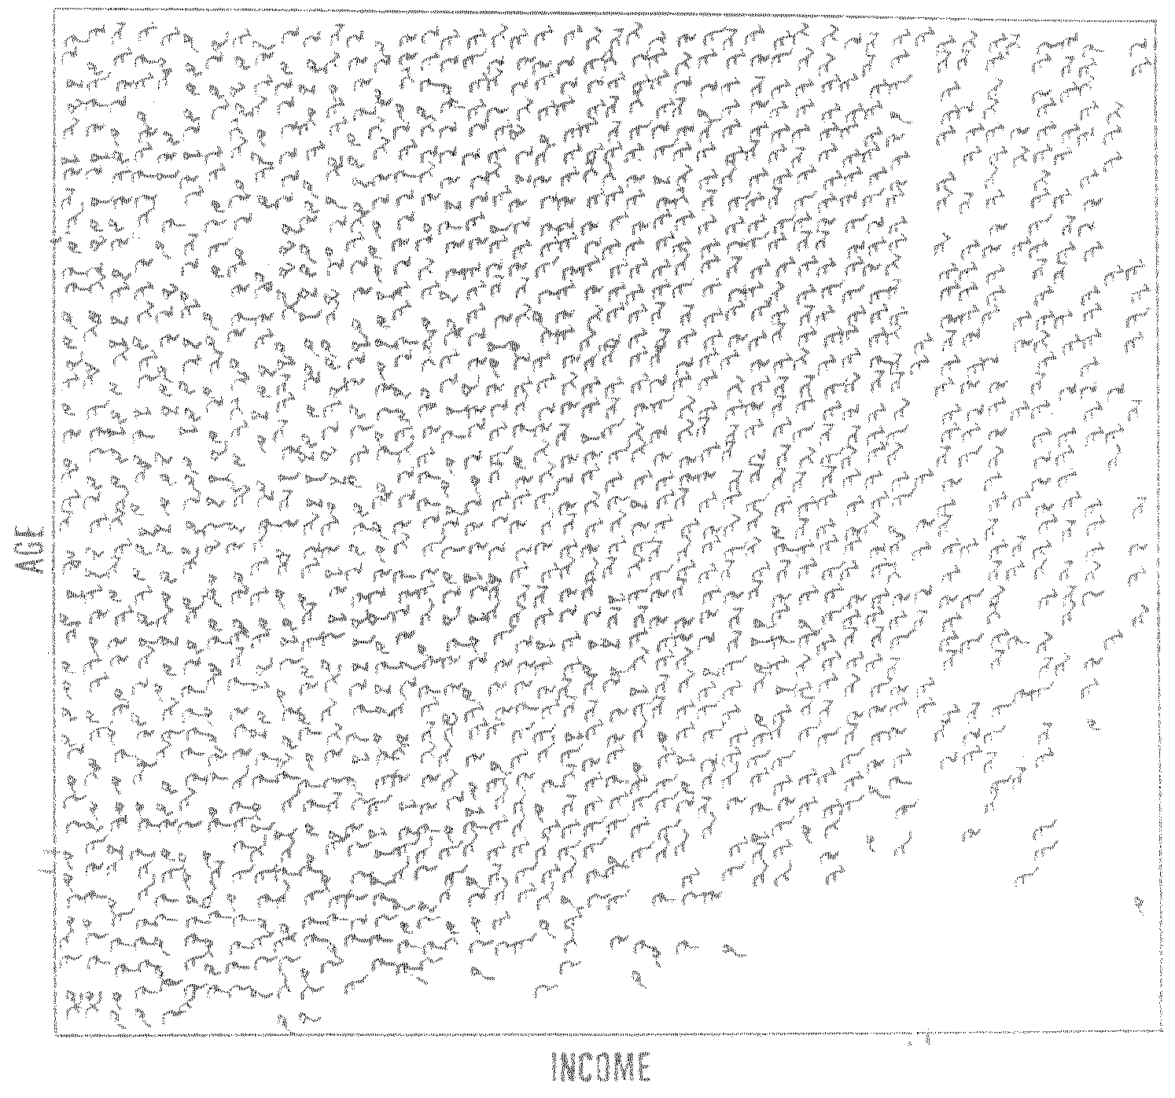
Stick Figure
A census data figure showing age, income, gender, education, etc.
used by permission of G. Grinstein, University of Massachusettes at Lowell
A 5-piece stick figure (1 body and 4 limbs w. different angle/length)
Two attributes mapped to axes, remaining attributes mapped to angle or length of limbs”. Look at texture pattern

Slide 37
Hierarchical Visualization Techniques
Visualization of the data using a hierarchical partitioning into subspaces
Methods
  Dimensional Stacking
  Worlds-within-Worlds
  Tree-Map
  Cone Trees
  InfoCube

Slide 38
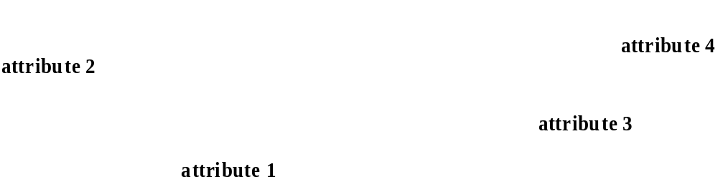
Dimensional Stacking
Partitioning of the n-dimensional attribute space in 2-D subspaces, which are ‘stacked’ into each other
Partitioning of the attribute value ranges into classes. The important attributes should be used on the outer levels.
Adequate for data with ordinal attributes of low cardinality
But, difficult to display more than nine dimensions
Important to map dimensions appropriately

Slide 39
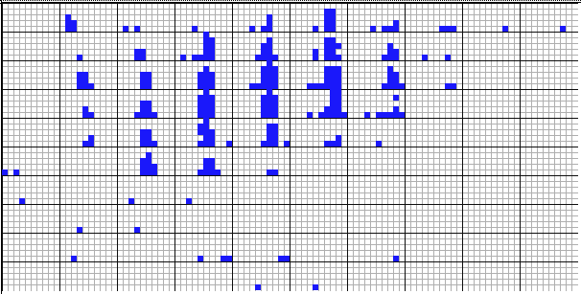
Dimensional Stacking
    Used by permission of M. Ward, Worcester Polytechnic Institute
Visualization of oil mining data with longitude and latitude mapped to the outer x-, y-axes and ore grade and depth mapped to the inner x-, y-axes

Slide 40
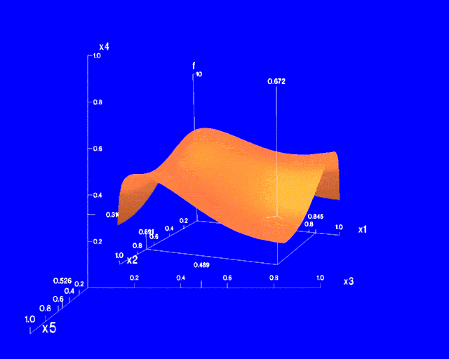
Worlds-within-Worlds
Assign the function and two most important parameters to innermost world
Fix all other parameters at constant values - draw other (1 or 2 or 3 dimensional worlds choosing these as the axes)
Software that uses this paradigm
  N–vision: Dynamic interaction through data glove and stereo displays, including rotation, scaling (inner) and translation (inner/outer)
  Auto Visual: Static interaction by means of queries

Slide 41
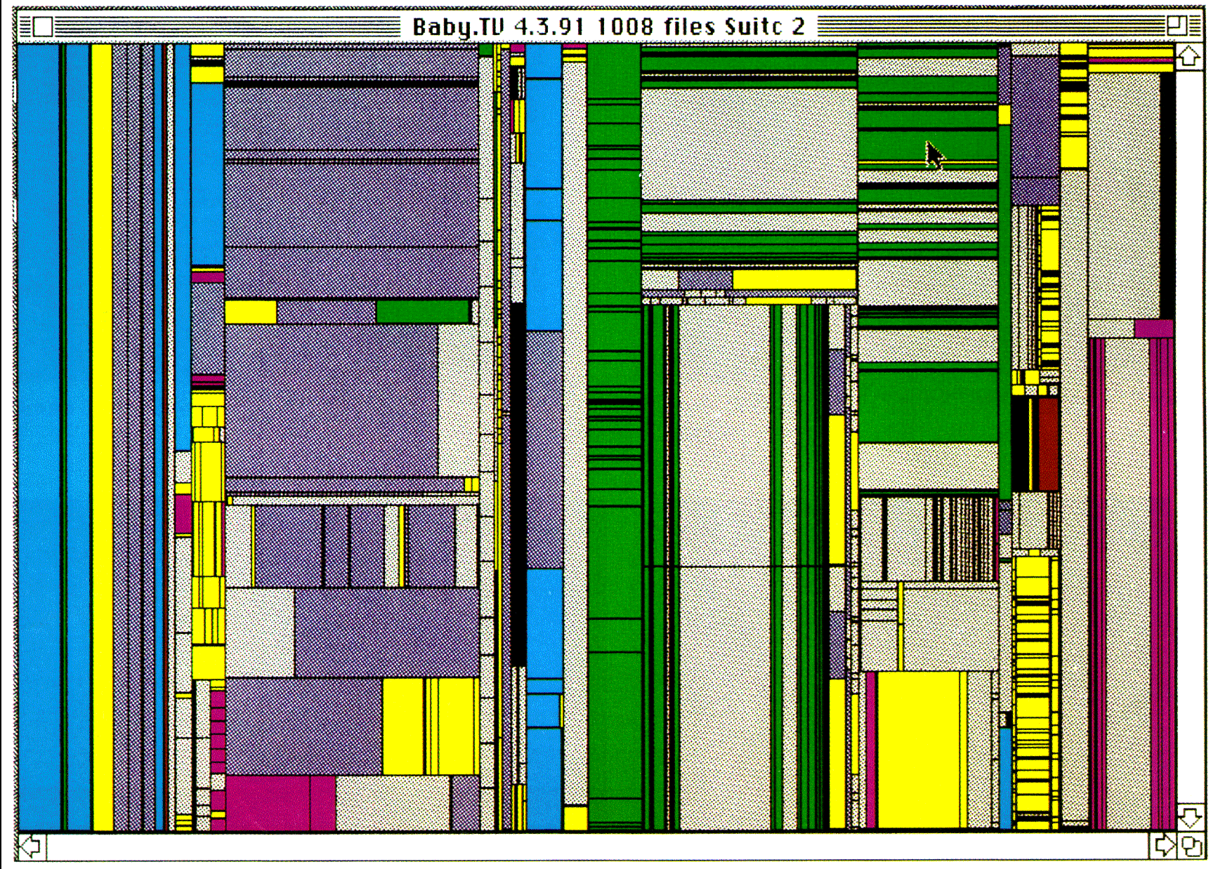
Tree-Map of a File System (Schneiderman)

Slide 42
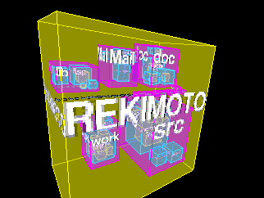
InfoCube
A 3-D visualization technique where hierarchical information is displayed as nested semi-transparent cubes
The outermost cubes correspond to the top level data, while the subnodes or the lower level data are represented as smaller cubes inside the outermost cubes, and so on

Slide 43
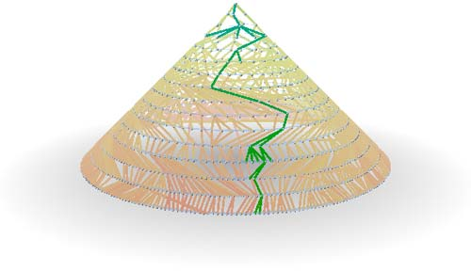
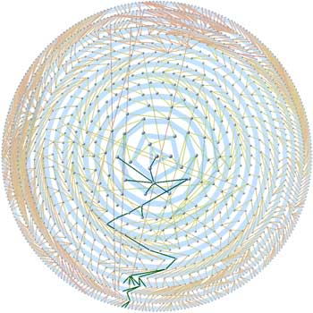
Three-D Cone Trees
3D cone tree visualization technique works well for up to a thousand nodes or so
First build a 2D circle tree that arranges its nodes in concentric circles centered on the root node
Cannot avoid overlaps when projected to 2D
Ack.: http://nadeausoftware.com/articles/visualization

Slide 44
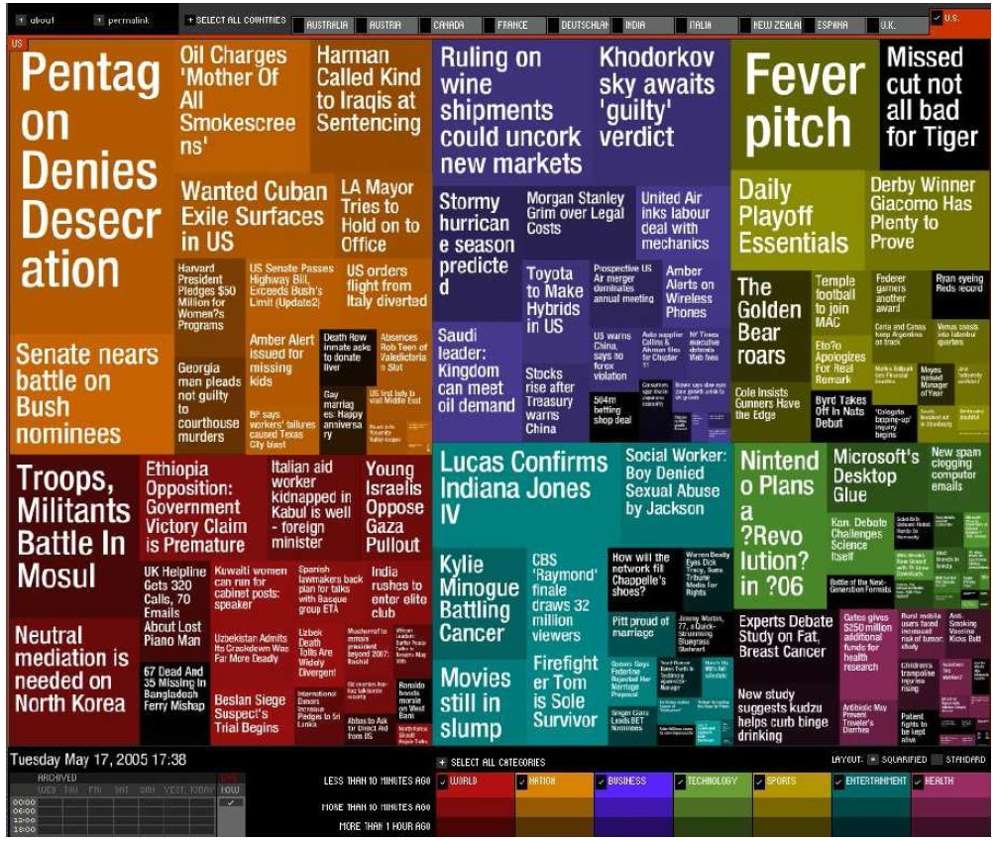
Visualizing Complex Data and Relations
Visualizing non-numerical data: text and social networks
Tag cloud: visualizing user-generated tags
  The importance of tag is represented by font size/color
Besides text data, there are also methods to visualize relationships, such as visualizing social networks
Newsmap: Google News Stories in 2005

